Slide 1
Web Science:
Social Networks
(Part 1 - Graphs)
CS 432/532
Old Dominion University
Permission has been granted to use these slides from Frank McCown, Michael L. Nelson, Alexander Nwala, Michele C. Weigle
This work is licensed under a Creative Commons Attribution-NonCommercial-ShareAlike 3.0 Unported License

Slide 2
Most slides based on Ch 2 of Networks, Crowds and Markets by Easley & Kleinberg (2010)
(abbreviated as EK10)
Kleinberg is the HITS guy (hubs and authorities)

Slide 3
Social Network
Definition: Graph composed of actors (people, organizations, groups) that are tied by social links
relationship
A
follows
B
actors

Slide 4
Online Social Networks (OSN)
Digital incarnation of a social network
Created by social network sites, social networking services
Web-based services that allows users to:¹
construct (semi-)public profiles within the system
"connect" to other users
view and traverse lists of connections created by others
¹Boyd & Ellison (2007) - Social Network Sites: Definition, History, and Scholarship

Slide 5










Slide 6
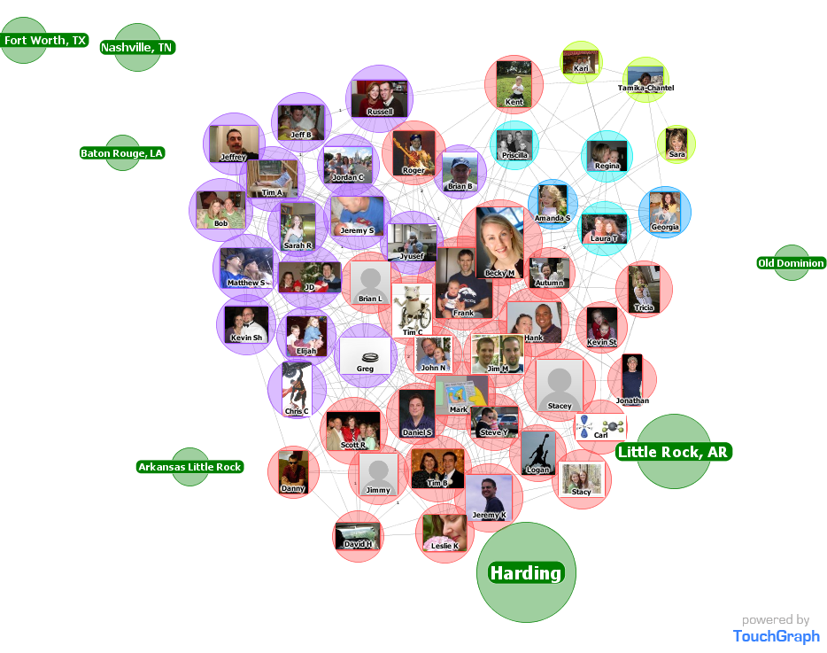
This is part of Dr. McCown’s friend group pre-2014.
In 2015, Facebook shut down the API that allowed apps to access your friends’ info without their permission.
Facebook Friends

Slide 7
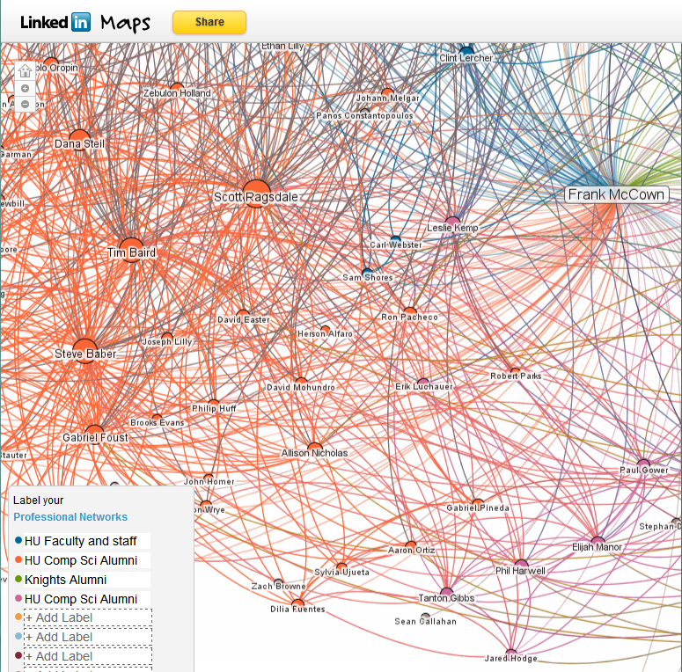
LinkedIn Maps
Visualize your LinkedIn network with InMaps, 2011
LinkedIn Is Quietly Retiring Network Visualization Tool InMaps , 2014

Slide 8
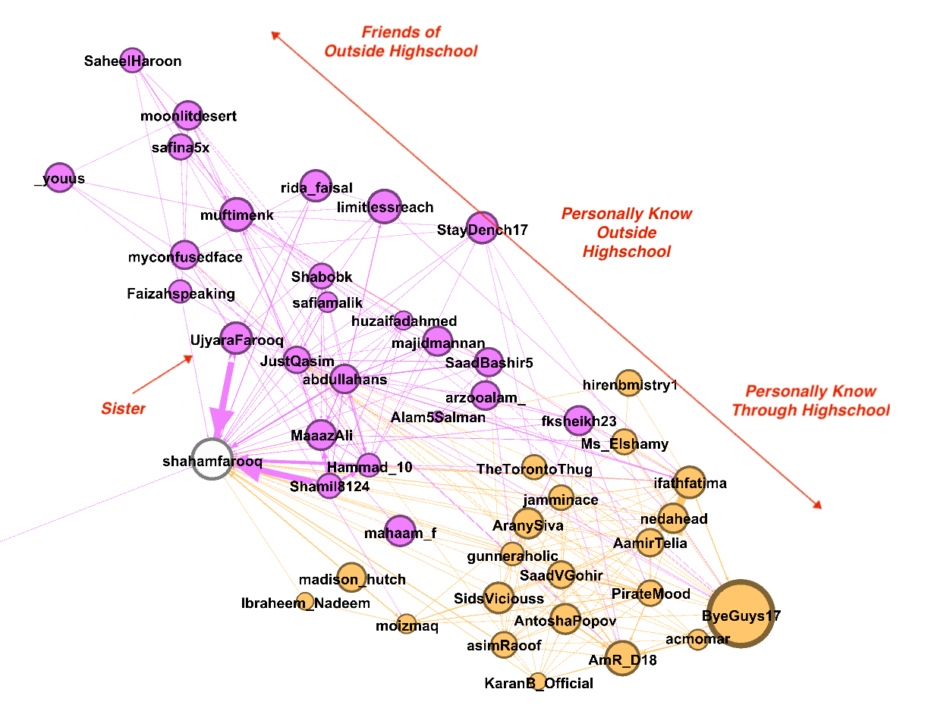
User-generated Twitter Network
Generating A Twitter Ego-Network & Detecting Communities | by Shaham

Slide 9
Why Study Social Networks?
Social scientists use social networks to study how people interact and develop theories of social behavior. OSNs offer opportunities to study social networks at a larger scale.
Understanding the structure of OSNs can lead to systems in the future that improve security, leverage trust, improve social interaction, etc.

Slide 10
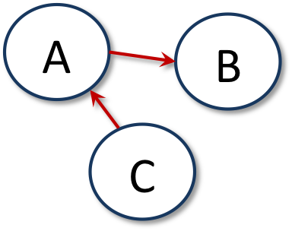

Graph Types
Directed
Undirected
e.g., Twitter followers
e.g., Facebook friends

Slide 11
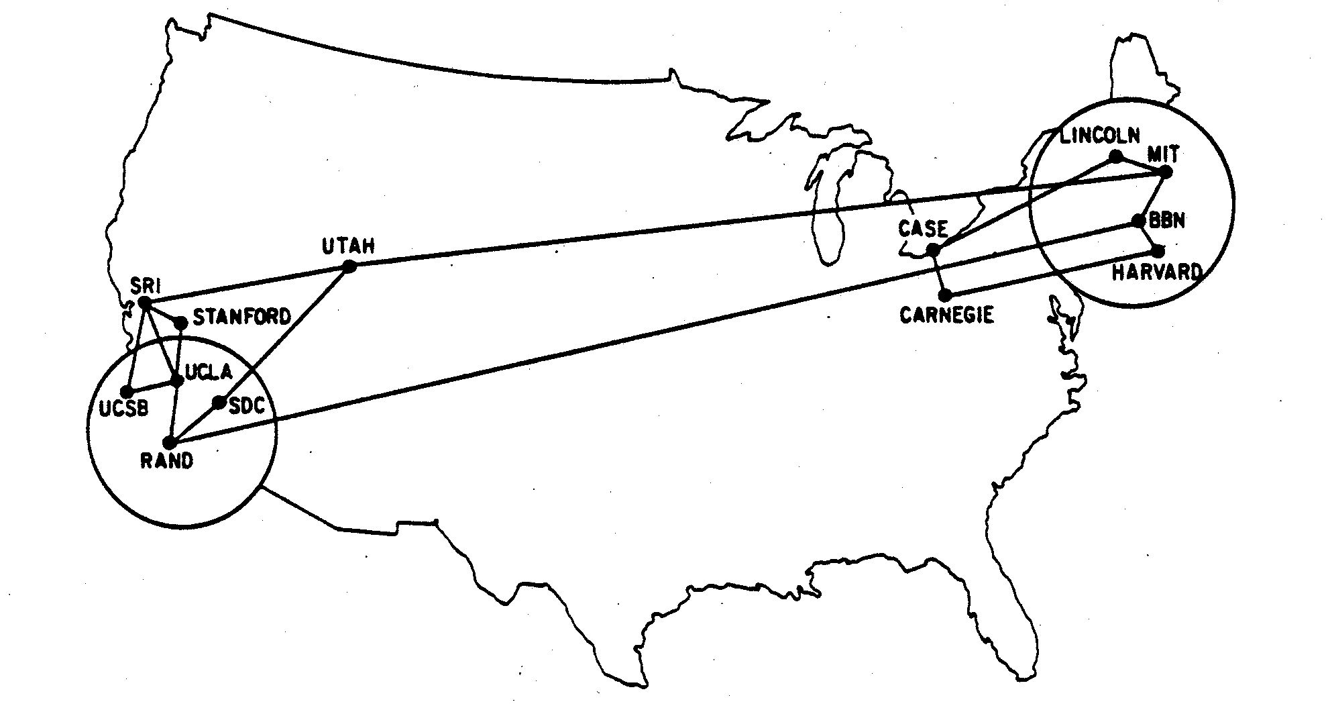
Cycles
Shortest cycle
Shortest cycle is SRI, STAN, UCLA, SRI
[EK10] Figure 2.2: A network depicting the sites on the Internet, then known as the Arpanet, in December 1970. (Image from F. Heart, A. McKenzie, J. McQuillian, and D. Walden)

Slide 12
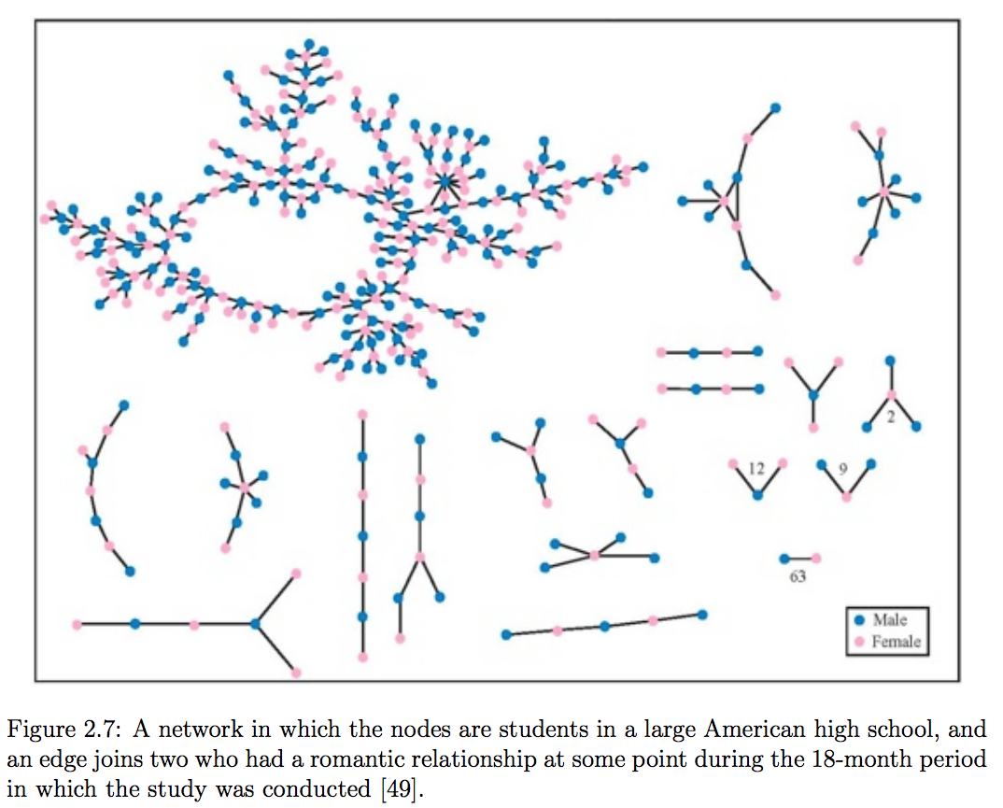
Components
Giant component
[EK10]

Slide 13
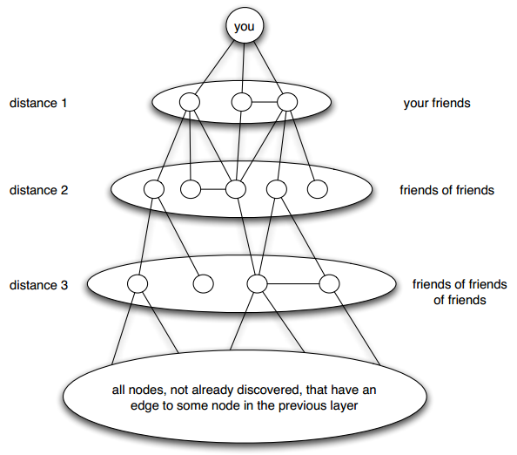
Distance
Length of shortest path
Breadth-first search
[EK10] Figure 2.8: Breadth-first search discovers distances to nodes one “layer” at a time; each layer is built of nodes that have an edge to at least one node in the previous layer.

Slide 14
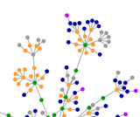

Small World Network
Six degrees of separation
first tested by Stanley Milgram in 1960s who found median length of 6 between two individuals
OSNs make studying this phenomena a little easier
Six degrees of Kevin Bacon
Erdos number
Six Degrees of Kevin Bacon (Wikipedia) / The Oracle of Bacon
Erdős number (Wikipedia)
My Erdos number is 3

Slide 15
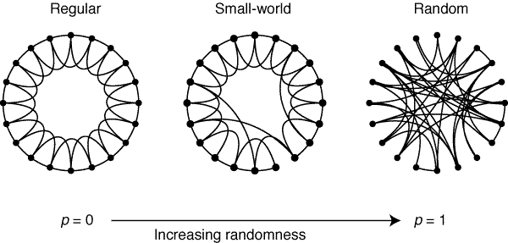
Regular → Small World → Random
Watts & Strogatz, "Collective dynamics of ‘small-world’ networks", Nature, 1998 (pdf)
Notes:
See: http://worrydream.com/refs/Watts-CollectiveDynamicsOfSmallWorldNetworks.pdf

Slide 16
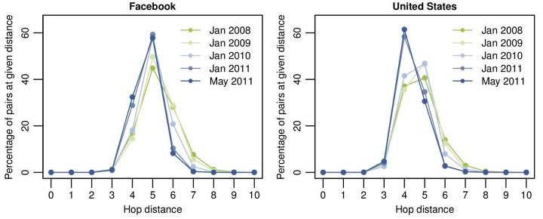
Four Degrees of Separation
Study of all Facebook users (721 million) in 2011 revealed avg distance of 4.74
Anatomy of Facebook

Slide 17
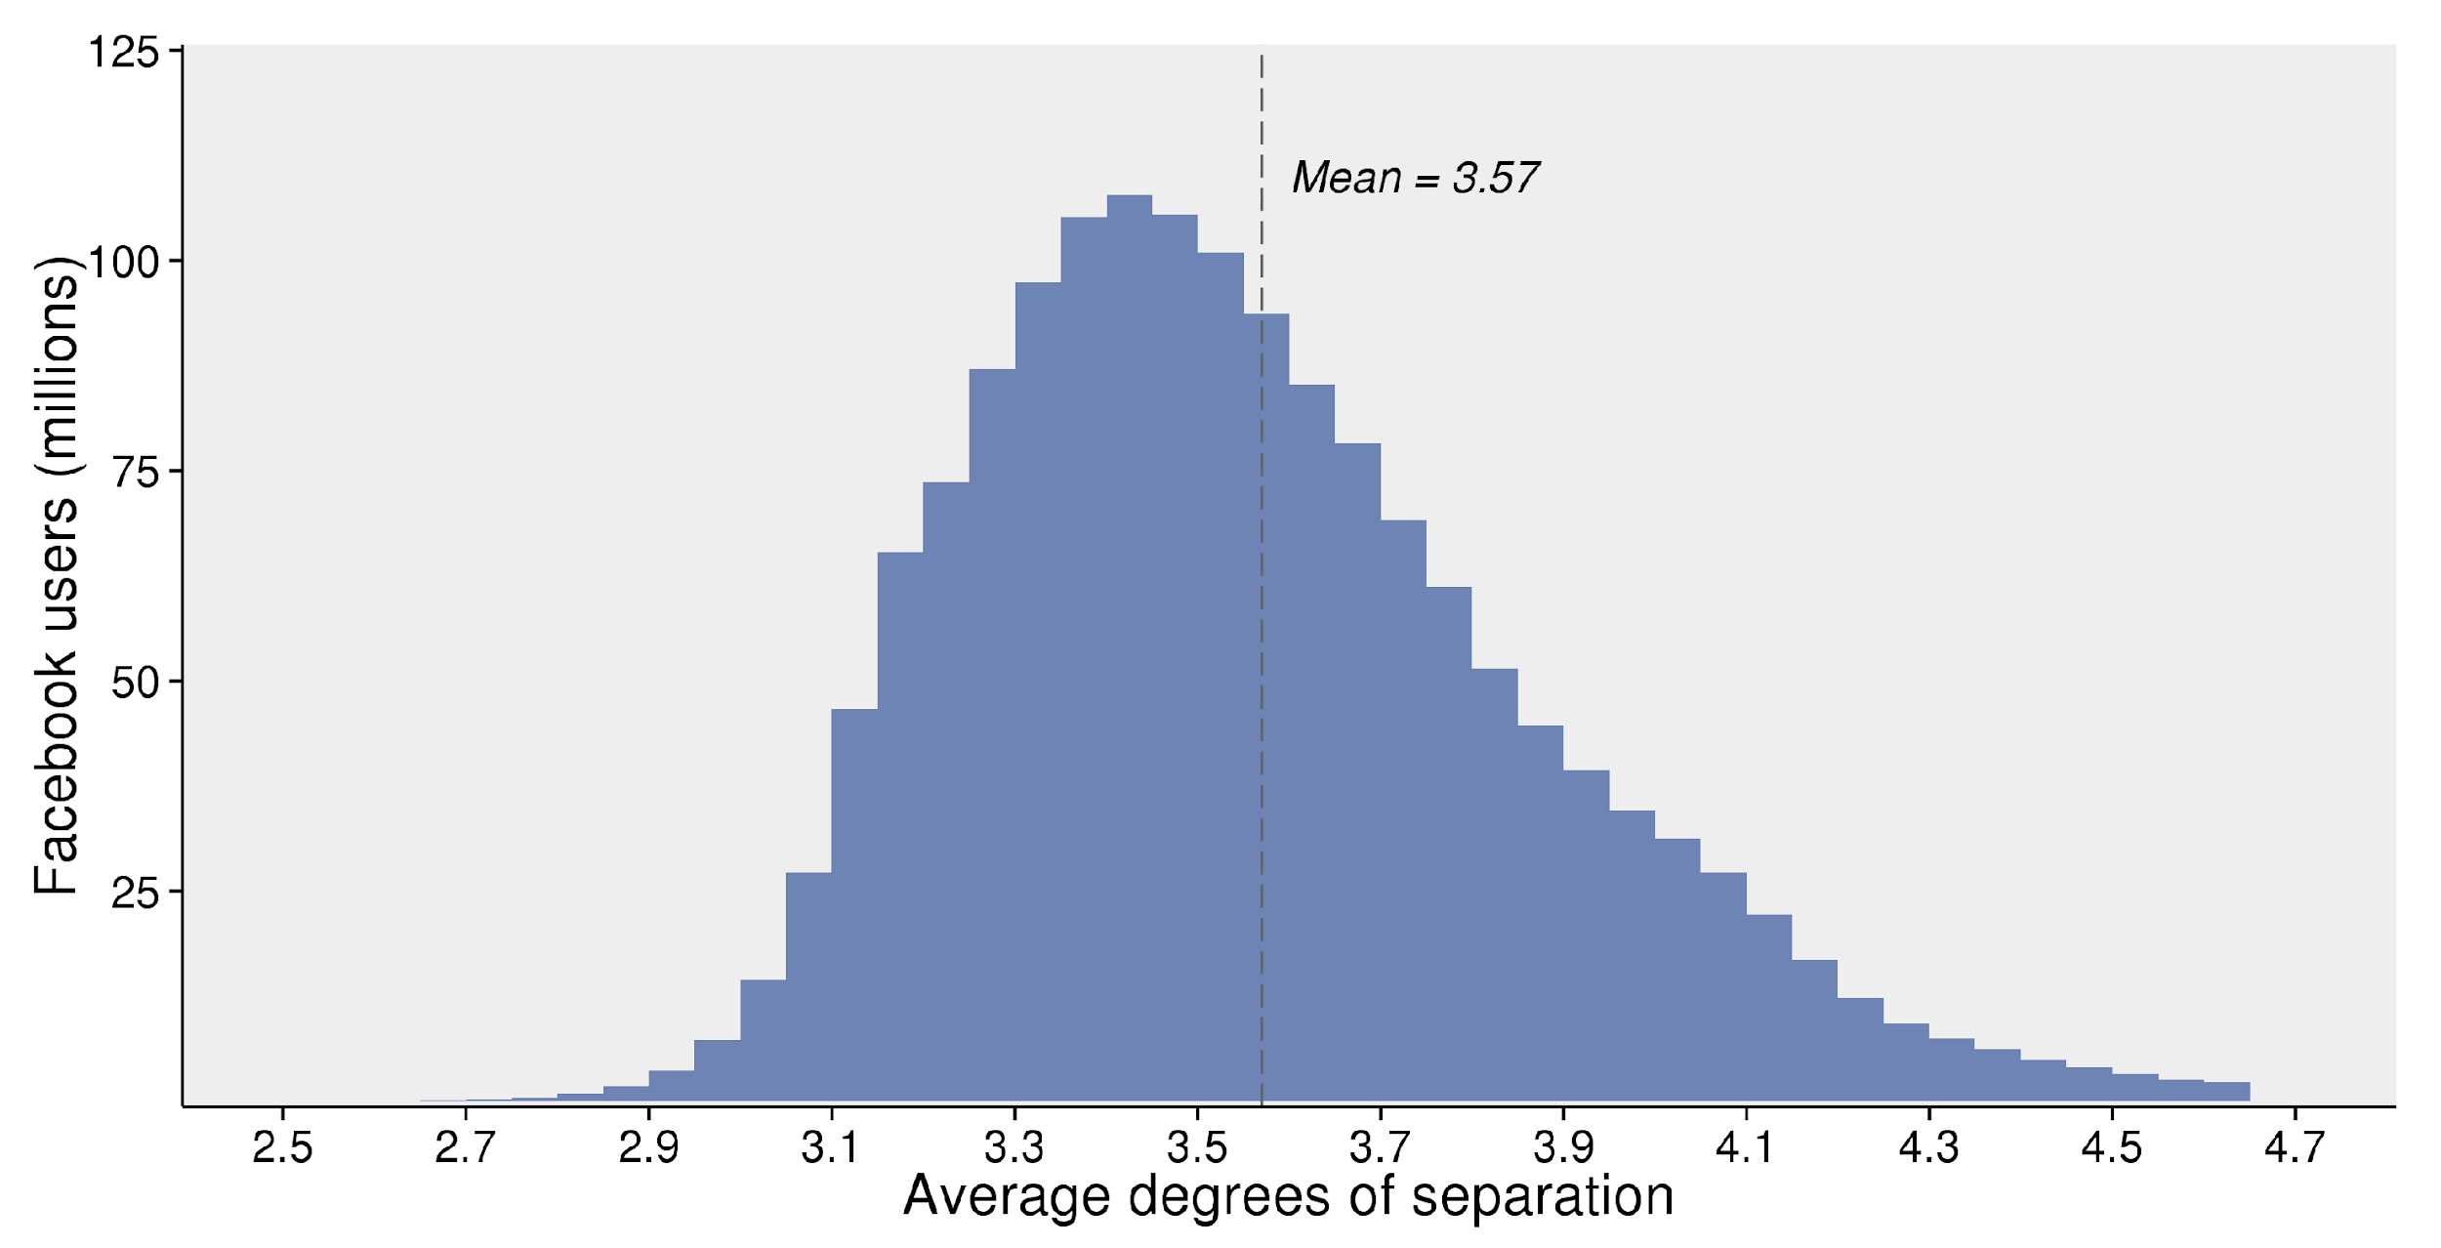
2016 Update: 3.57 Degrees
Three and a half degrees of separation

Slide 18
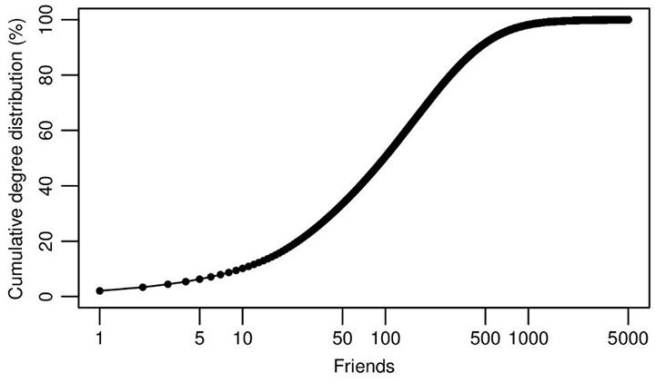
How Many Friends?
Anatomy of Facebook
example of a CDF: Cumulative distribution function (Wikipedia)

Slide 19
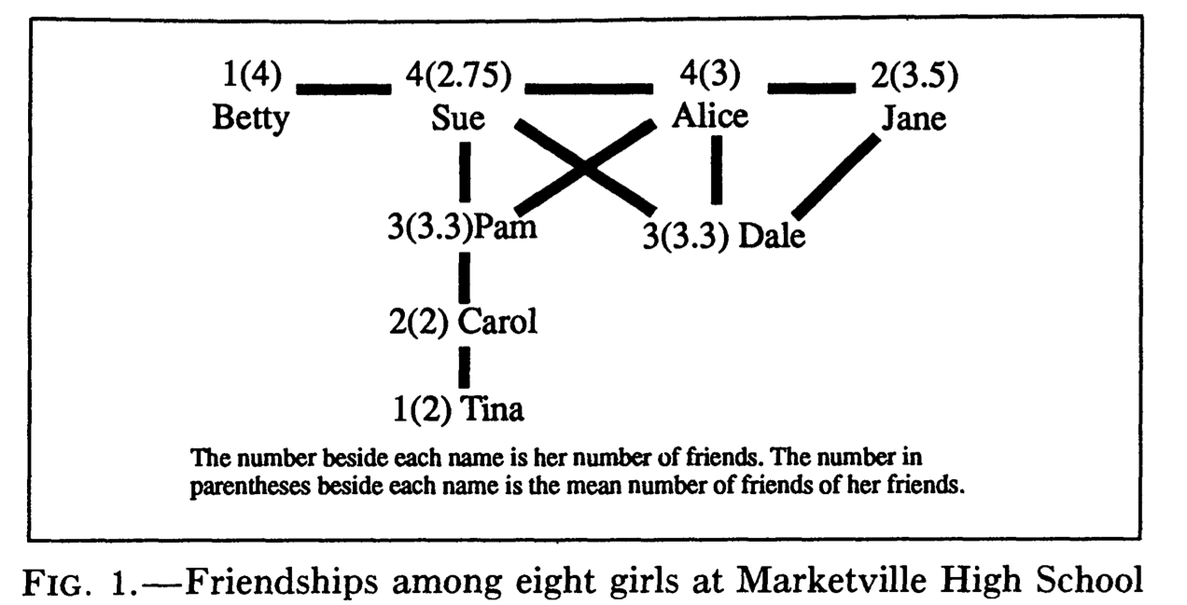
"Friendship Paradox"
Fun fact: your friends have more friends than you do.
Feld, "Why Your Friends Have More Friends Than You Do" (pdf)
Friendship paradox (Wikipedia)
Your friends are also happier than you: The happiness paradox: your friends are happier than you

Slide 20
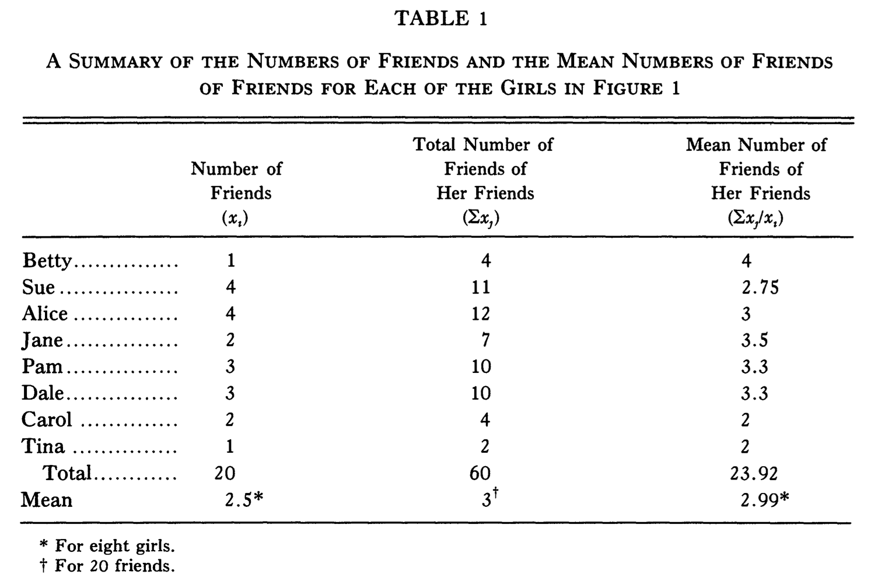
Sue & Alice Rule Marketville
(Carol is doing ok)

Slide 21
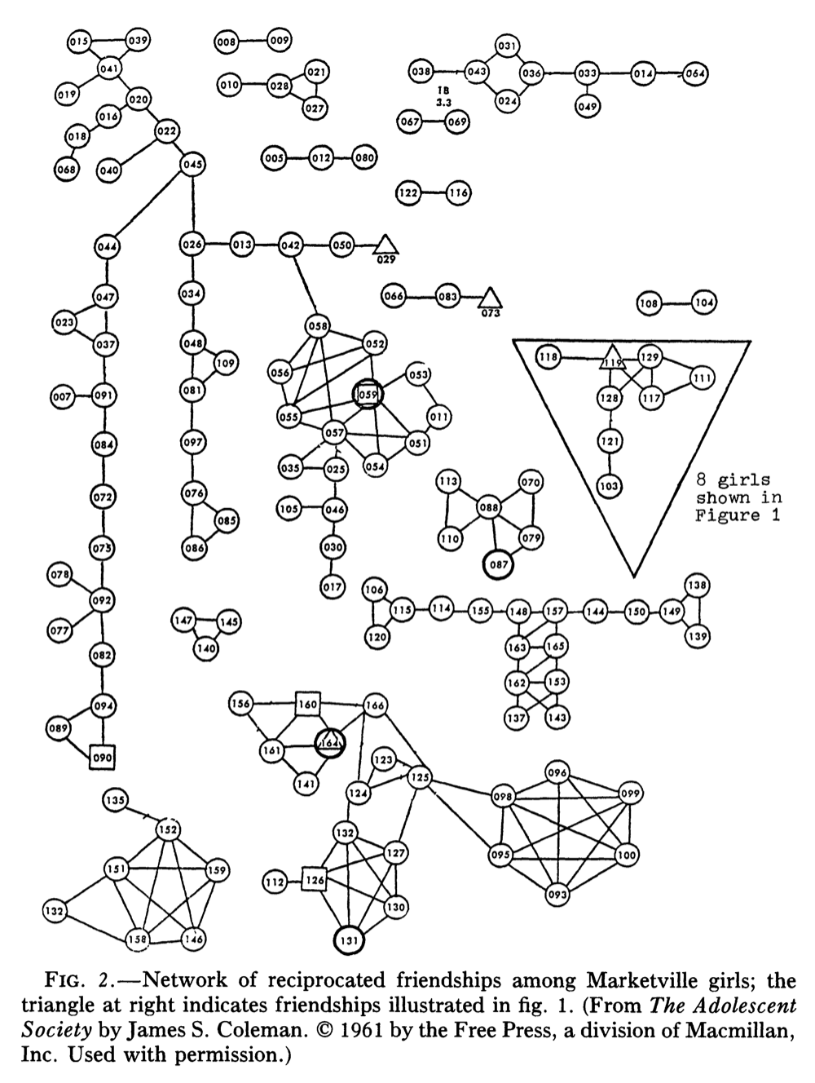
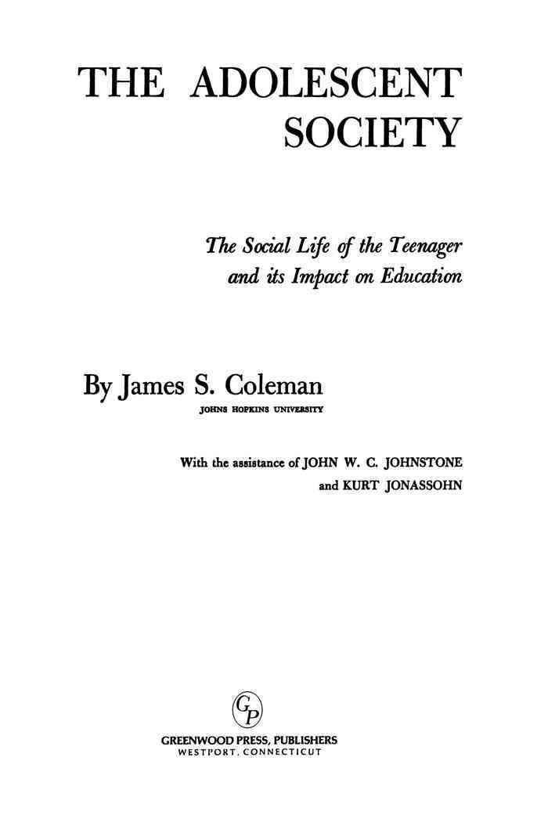
Complete Network
of Marketville
In 1961 study, friendship is via bi-directional
naming in a questionnaire (i.e., Facebook style).

Slide 22
Web Science:
Social Networks
(Part 2 - Strong and Weak Ties)
CS 432/532
Old Dominion University
Permission has been granted to use these slides from Frank McCown, Michael L. Nelson, Alexander Nwala, Michele C. Weigle
This work is licensed under a Creative Commons Attribution-NonCommercial-ShareAlike 3.0 Unported License

Slide 23
Most slides based on Ch 3 of Networks, Crowds and Markets by Easley & Kleinberg (2010)
(abbreviated as EK10)
Kleinberg is the HITS guy (hubs and authorities)

Slide 24
Network Evolution
Social networks tend to change over time
You make new friends, lose contact with others
You change schools, jobs, etc.
We're often interested in examining multiple snapshots of the social graph through time

Slide 25
"If two people in a social network have a friend in common, then there is an increased likelihood that they will become friends themselves at some point in the future."
- Anatole Rapoport (1953)

Slide 26
Triadic Closure
Common friend
A
B
C
Likely to appear
Notes:
See: https://www.cs.cornell.edu/home/kleinber/networks-book/networks-book-ch03.pdf

Slide 27
Reasons for Triadic Closure
Opportunity – A spending time with B & C increases chance they will meet
Trust – Research shows that B & C are more likely to trust each other if they are aware of mutual friend A
Incentive – Research shows that latent stress occurs when mutual friends are not friends with each other

Slide 28
Measuring Triadic Closure
Clustering coefficient – probability that any two randomly selected friends of a node are also friends
CC = 0 when none of node's friends are friends with each other
CC = 1 when all of node's friends are friends with each other
# of friend pairs
CC for a node =
# of possible friend pairs

Slide 29
Clustering Coefficient
A's CC: BC / BC = 1
F's CC: - / BE = 0
A
B
C
D
F
C's CC: AB / AB, AD, BD = 1/3
E
CC for a node = # of friend pairs / # of possible friend pairs

Slide 30
Bridges
A
B
Edge is a bridge if removing the edge creates two components

Slide 31
Local Bridges
C
A
B
Edge is a local bridge if endpoints have no friends in common

Slide 32
Local Bridges
C
A
B
Removing a local bridge does not create two components!

Slide 33
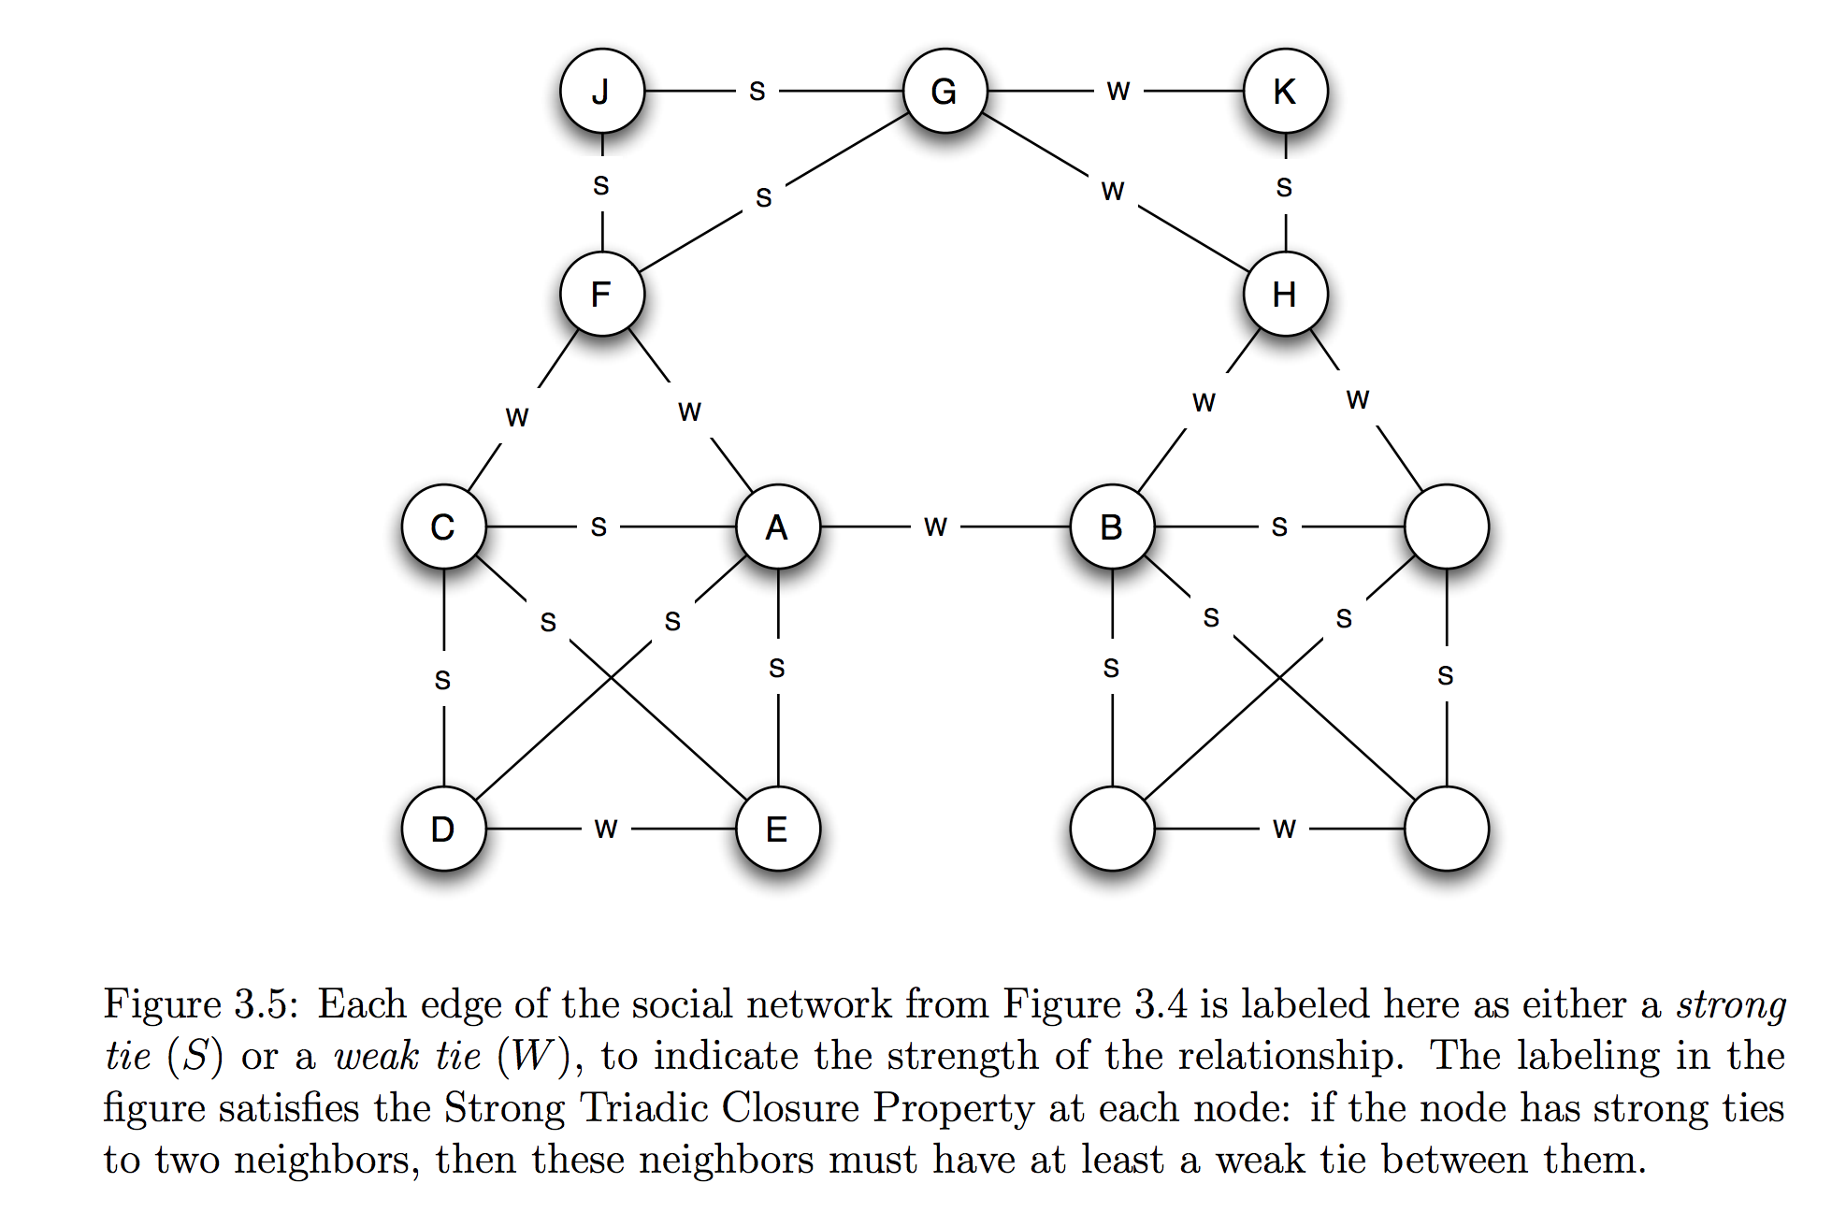
Strong and Weak Ties
[EK10]
Not everyone is your BFF!

Slide 34
Variable Tie Strength
0
6
10
C
1
9
A
B
Can use more fine-grained methods to determine tie strength, like number of Facebook messages exchanged

Slide 35
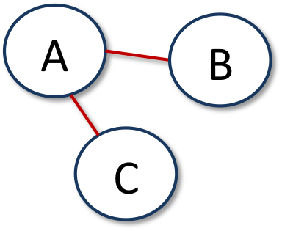
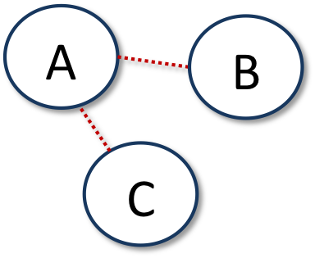
Tie Strength and Triadic Closure
More likely to form
Less likely to form
Triadic closure is more likely to form when initial edges are strong

Slide 36
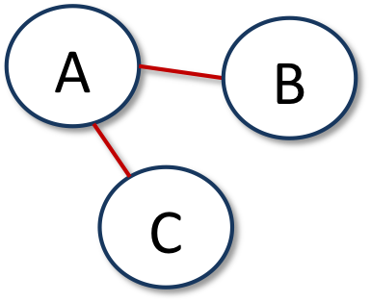
Strong Triadic Closure Property
Node A satisfies the Strong Triadic Closure Property if it has strong ties to two other nodes B and C, and there is some edge between B and C
satisfies
violates
A
B
C

Slide 37
Strong Triadic Closure and Bridges
Can a node with at least 2 strong edges satisfy the STC property and be involved in a local bridge that is a strong tie?
C
A
B
?
Answer: No! Why not?

Slide 38
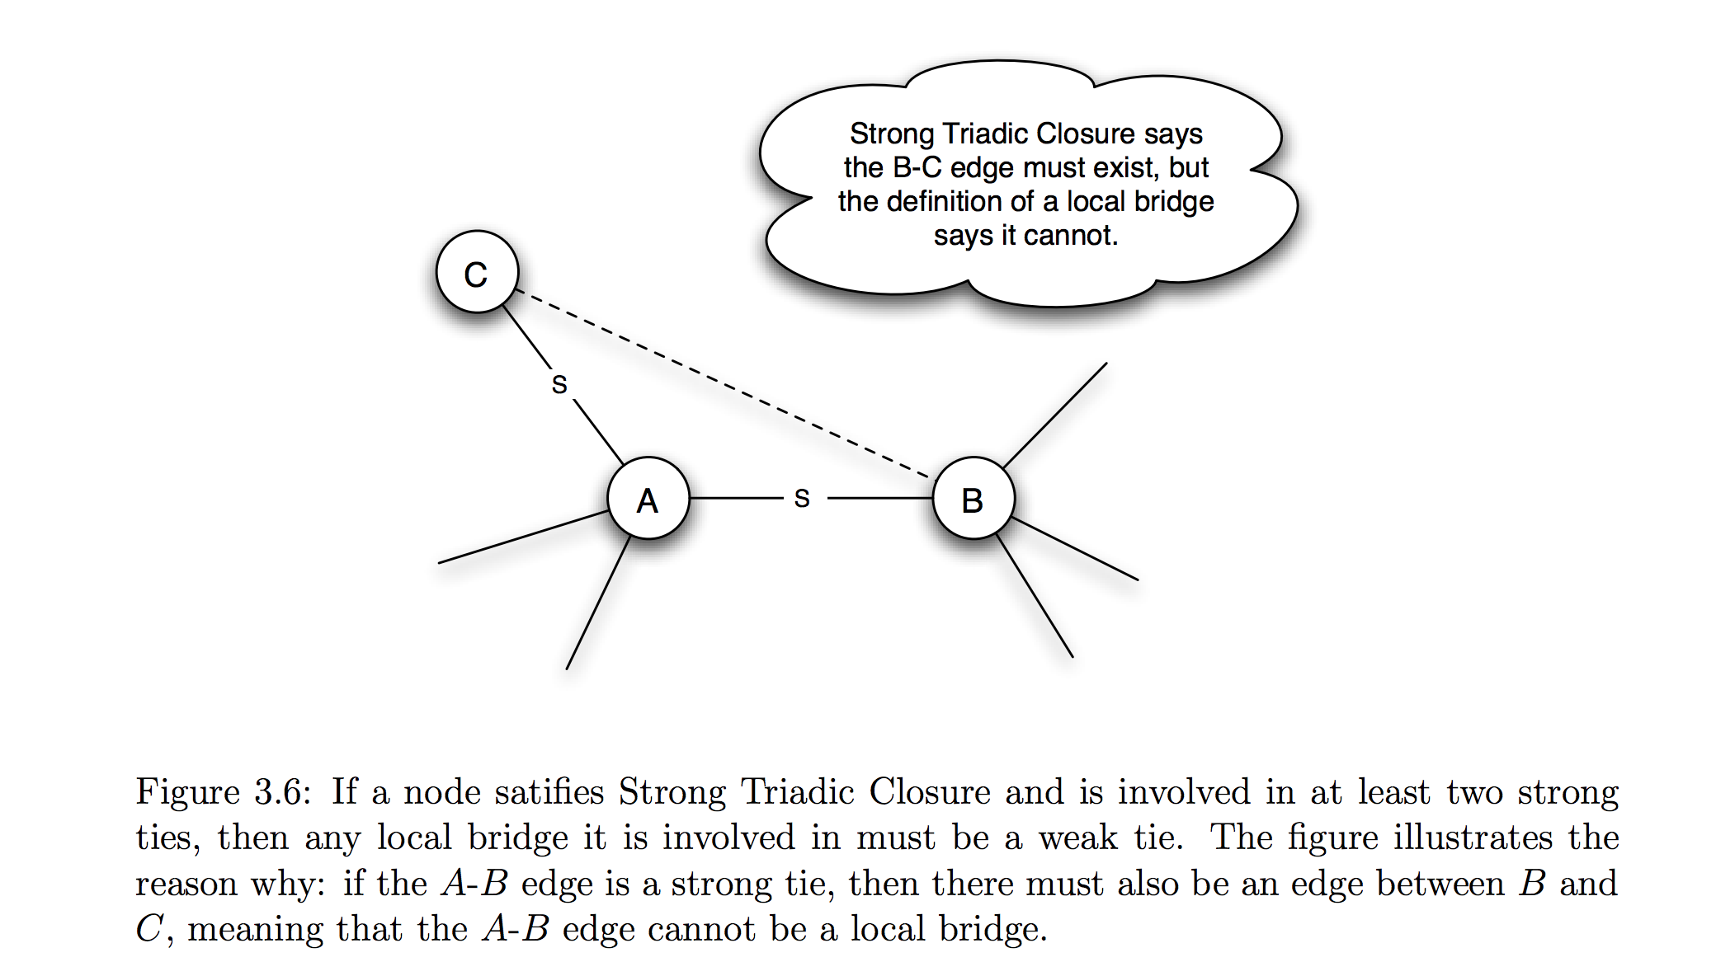
Strong Triadic Closure and Bridges
Can a node with at least 2 strong edges satisfy the STC property and be involved in a local bridge that is a strong tie?
[EK10]
Answer: No! Why not?

Slide 39
Strong Triadic Closure and Bridges
STC property says edge must form when two strong edges emanate from the same node
Therefore a network that satisfies the STC property and has a sufficient number of strong ties will likely have only weak local bridges
Does not always hold in real social networks, but useful theoretical framework in which to understand connections and test theories

Slide 40
Web Science:
Social Networks
(Part 3 - Tie Strength and Embeddedness)
CS 432/532
Old Dominion University
Permission has been granted to use these slides from Frank McCown, Michael L. Nelson, Alexander Nwala, Michele C. Weigle
This work is licensed under a Creative Commons Attribution-NonCommercial-ShareAlike 3.0 Unported License

Slide 41
Most slides based on Ch 3 of Networks, Crowds and Markets by Easley & Kleinberg (2010)
(abbreviated as EK10)
Kleinberg is the HITS guy (hubs and authorities)

Slide 42
Large-Scale Data Studies
Put new concepts to work by examining several large-scale studies
Examples:
Cell phone usage
Facebook
Twitter

Slide 43
Cell Phone Social Network
18 weeks of cell phone data covering 20% of country's population
Node = cell phone user
Edge = if two nodes called each other (both directions)
Tie strength = duration of calls
rather than just “strong” or “weak”
Onnela et al., Structure and tie strengths in mobile communication networks (2007)

Slide 44
Cell Phone Social Network
Instead of determining if edge is a local bridge or not, use neighborhood overlap
= 1 if all neighbors of A and B are connected
= 0 if no neighbors are connected (local bridge)
Close to 0 is "almost" a local bridge
Neighborhood overlap
neighbors of both A and B
=
neighbors of A or B

Slide 45
Neighborhood Overlap
D
C
E
A
B
F
G
Neighborhood overlap of AD
E
=
=
1/5
C, E, F, G, B

Slide 46
Neighborhood Overlap
D
C
E
A
B
F
G
Neighborhood overlap of AB
-
=
=
0
D, E, F, G, etc.

Slide 47
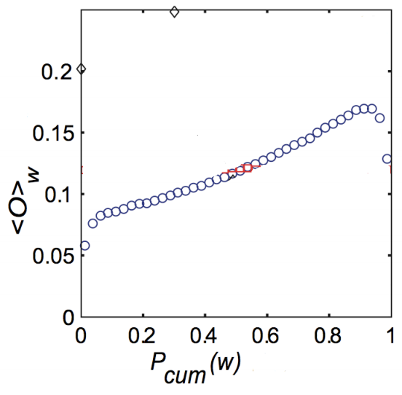
Neighborhood Overlap
Q: What's happening here?
A: We're not sure. Unusual
phone usage?
Onnela et al.'s findings
Tie Strength
[EK10] Fig 3.7. A plot of the neighborhood overlap of edges as a function of their percentile in the sorted order of all edges by tie strength.

Slide 48
Removing Ties
84% of cell phone graph nodes lay in a single giant component
Do weak ties link strongly connected components?
Removed edges one at a time starting with strongest edges → giant component slowly erodes
Removed edges starting with weakest edges → giant component shrank quicker, remnants broke apart quickly once critical weak edges removed

Slide 49
Tie Strength on Facebook
Marlow et al., Maintained relationships on Facebook, 2009
Analyzed tie strength of Facebook users using one month of interactions

Slide 50
Three Categories of Links
Reciprocal/Mutual – messages sent both ways
One-way – at least one message sent (friend may or may not have reciprocated)
Maintained – user clicked on friend's content (from feed) or profile more than once

Slide 51
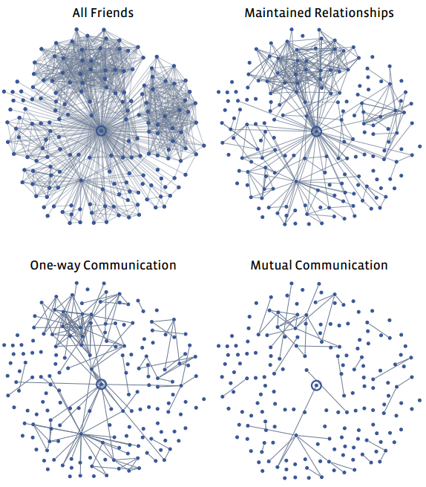
Typical User's Network
College & high school friends?
Less interest
[EK10] Fig 3.8
Maintained Relationships on Facebook

Slide 52
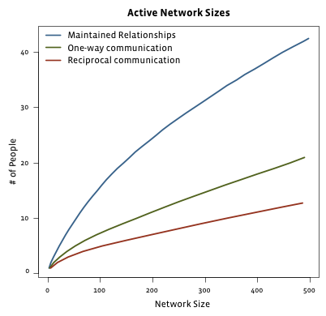
Limits to Maintaining Relationships
passive engagement
Reciprocal – messages sent both ways
One-way – at least one message sent
Maintained – user clicked on Friend's content (from feed) or profile more than once
[EK10] Fig 3.9
Can't keep up with everyone!
Maintained Relationships on Facebook

Slide 53
Tie Strength on Twitter
Analyzed tie strength of 211,024 active Twitter users during observation period
Followees – people being followed
Friend – person who user has directed at least 2 tweets to (strong ties)
Huberman et al., Social networks that matter: Twitter under the microscope, First Monday, Jan 2009

Slide 54
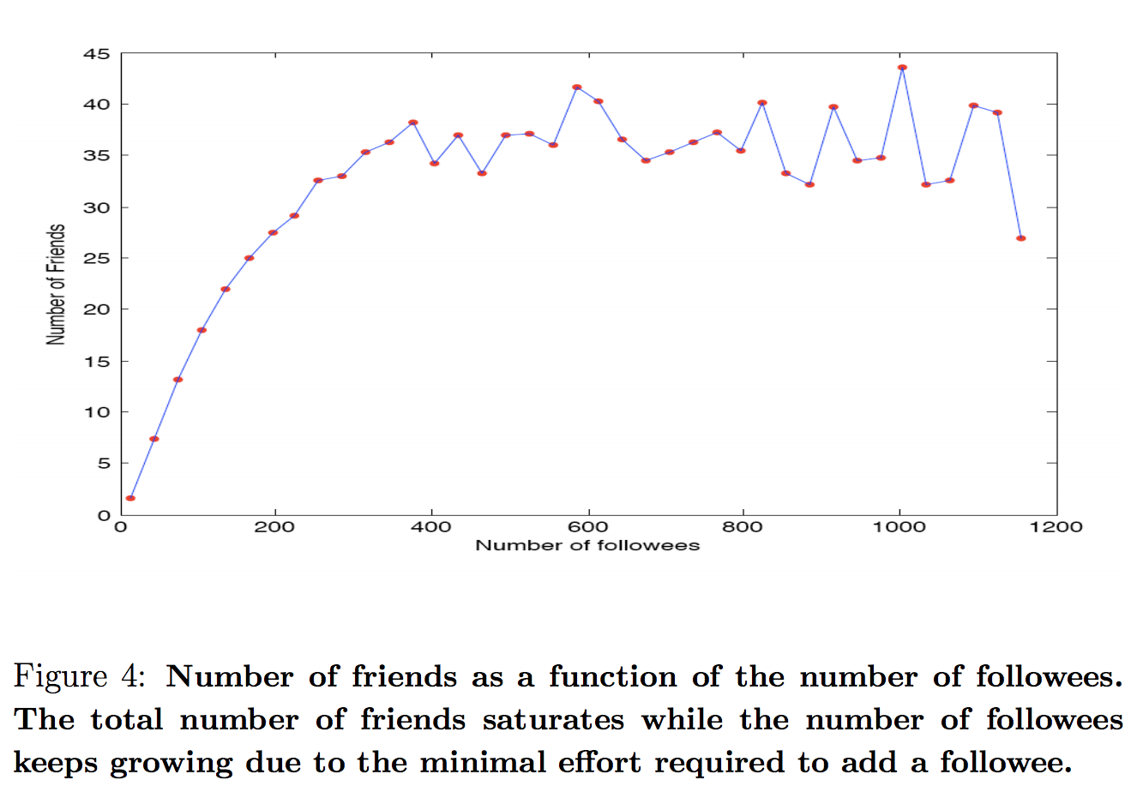
Friends vs. Followees
Limit on the number of strong ties a user can maintain
Huberman et al., Social networks that matter: Twitter under the microscope, First Monday, Jan 2009

Slide 55
Now let's look at the edges to see which nodes are “important”…

Slide 56
Edge Embeddedness
Defined as the number of common neighbors shared by two endpoints
Equal to numerator in neighborhood overlap
Local bridges have embeddedness of zero
A
Embeddedness of A-B = 1
Embeddedness of A-C = 2
B
D
C

Slide 57
Edge Embeddedness Example
C
Zero embeddedness
B
A
D
All edges have high embeddedness

Slide 58
Embeddedness and Trust
Research shows that if you and I are connected by an embedded edge (we share a mutual friend), there is more trust and confidence in the integrity of the transactions (social, economic, etc.) between us
If I cheat you, our mutual friends are likely to find out, and they are less likely to trust me in the future!
Threat is absent for edges of zero embeddedness; no mutual friends to punish me!

Slide 59
C
Riskier
B
A
D
High levels
of trust
B also must deal with potentially contradictory norms and expectations from various groups

Slide 60
It's good to be B…
C
A
B
D
Node B is at the end of multiple local bridges
Node B spans a structural hole in the network – space between two components that do not interact closely
If network represents a company or organization, some advantages for B:
B has early access to info that originates in various components
Having access to this info can amplify B's creativity by combining disparate info into novel ideas
B acts as "gatekeeper" and can control flow of information to various components
B seems “smart” to everybody else…

Slide 61
C
Riskier
B
A
D
High levels
of trust
Who would you rather be? A with trusted relationships or risk-taker B?

Slide 62
Web Science:
Social Networks
(Part 4 - Graph Partitioning)
CS 432/532
Old Dominion University
Permission has been granted to use these slides from Frank McCown, Michael L. Nelson, Alexander Nwala, Michele C. Weigle
This work is licensed under a Creative Commons Attribution-NonCommercial-ShareAlike 3.0 Unported License

Slide 63
Most slides based on Ch 3 of Networks, Crowds and Markets by Easley & Kleinberg (2010)
(abbreviated as EK10)
Kleinberg is the HITS guy (hubs and authorities)

Slide 64
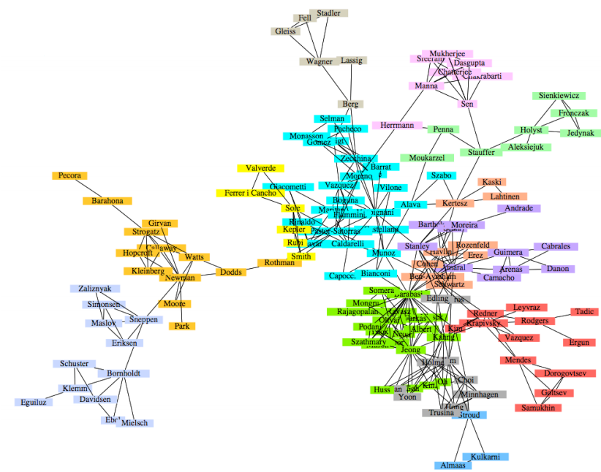
Co-authorship network How can the tightly clustered groups be identified mathematically?
We can often “eyeball” clusters, important nodes
We often are interested in link prediction
Newman & Girvan, Finding and evaluating community structure in networks, Physical Review E, 69(2), 2004

Slide 65
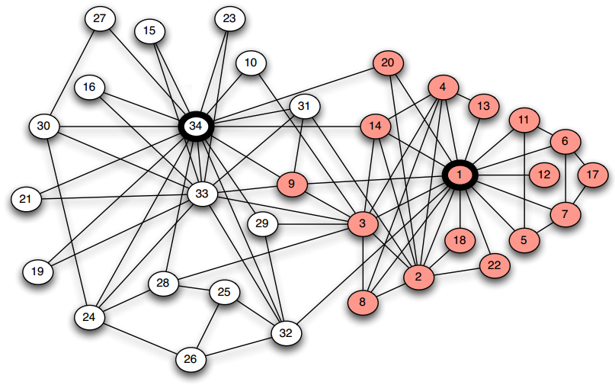
Karate Club splits after a dispute. Can new clubs be identified based on network structure?
Zachary W. (1977). An information flow model for conflict and fission in small groups. Journal of Anthropological Research, 33, 452-473.
Zachary's karate club (Wikipedia) / see data set at ZACHARY KARATE CLUB at UCINET IV Datasets and Zachary karate club at KONECT (archived)

Slide 66
Graph Partitioning
Methods to break a network into sets of connected components called regions
Many general approaches
Divisive methods: Repeatedly identify and remove edges connecting densely connected regions
Agglomerative methods: Repeatedly identify and merge nodes that likely belong in the same region

Slide 67
Divisive Methods
1
10
2
3
9
11
7
8
4
6
12
13
5
14

Slide 68
Agglomerative Methods
1
10
2
3
9
11
7
8
4
6
12
13
5
14

Slide 69
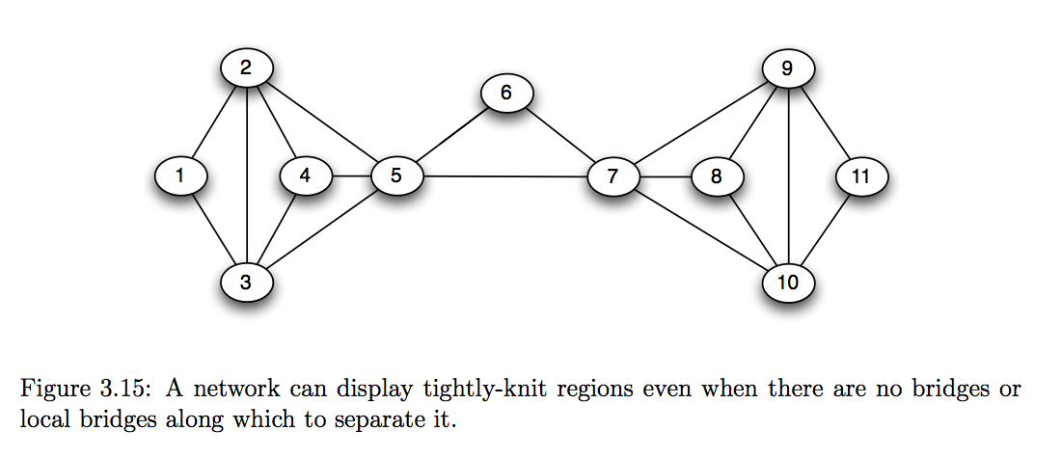
How to split/cluster?
[EK10]

Slide 70
Girvan-Newman Algorithm
Divisive method - Uses edge betweenness to identify edges to remove
Edge betweenness: Total amount of "flow" an edge carries between all pairs of nodes
a single unit of flow between two nodes divides itself evenly among all shortest paths between the nodes (1/k units flow along each of k shortest paths)
Betweenness is a measure of centrality, or importance, in a graph
Girvan M. and Newman M. E. J., "Community structure in social and biological networks", Proc. Natl. Acad. Sci. USA 99, 7821–7826 (2002)
Centrality (Wikipedia)

Slide 71
Edge Betweenness Example
1
10
Calculate total flow over edge 7-8
2
3
9
11
7
8
4
6
12
13
5
14

Slide 72
1
10
2
3
One unit flows over 7-8 to get from 1 to 8
9
11
7
8
4
6
12
13
5
14

Slide 73
1
10
2
3
One unit flows over 7-8 to get from 1 to 9
9
11
7
8
4
6
12
13
5
14

Slide 74
1
10
2
3
One unit flows over 7-8 to get from 1 to 10
9
11
7
8
4
6
12
13
5
14

Slide 75
1
10
2
3
9
11
7
8
4
6
12
13
5
7 total units flow over 7-8 to get from 1 to nodes 8-14
14

Slide 76
1
10
2
3
9
11
7
8
4
6
12
13
5
7 total units flow over 7-8 to get from 2 to nodes 8-14
14

Slide 77
1
10
2
3
9
11
7
8
4
6
12
13
5
7 total units flow over 7-8 to get from 3 to nodes 8-14
14

Slide 78
7 x 7 = 49 total units flow over 7-8 from nodes 1-7 to 8-14
1
10
2
3
9
11
7
8
4
6
12
13
5
14

Slide 79
1
Edge betweenness = 49
10
2
3
9
11
7
8
4
6
12
13
5
14

Slide 80
1
10
Calculate betweenness for edge 3-7
2
3
9
11
7
8
4
6
12
13
5
14

Slide 81
1
10
3 units flow from 1-3 to each 4-14 node,
so total = 3 x 11 = 33
2
3
9
11
7
8
4
6
12
13
5
14

Slide 82
1
Betweenness = 33
for each symmetric edge
10
2
3
9
11
33
33
7
8
33
33
4
6
12
13
5
14

Slide 83
1
10
Calculate betweenness for edge 1-3
2
3
9
11
7
8
4
6
12
13
5
14

Slide 84
1
10
Carries all flow to node 1 except from node 2,
so betweenness = 12
2
3
9
11
7
8
4
6
12
13
5
14

Slide 85
1
10
betweenness = 12
for each symmetric edge
12
12
2
3
9
11
12
12
7
8
4
12
6
12
12
13
12
12
5
14

Slide 86
1
10
Calculate betweenness for edge 1-2
2
3
9
11
7
8
4
6
12
13
5
14

Slide 87
1
10
Only carries flow from 1 to 2, so betweenness = 1
2
3
9
11
7
8
4
6
12
13
5
14

Slide 88
1
10
betweenness = 1 for each symmetric edge
1
1
2
3
9
11
7
8
4
6
12
13
1
1
5
14

Slide 89
1
10
Edge with highest betweenness
1
12
12
1
2
3
9
11
12
12
33
33
7
49
8
33
33
4
12
6
12
12
13
1
12
12
1
5
14

Slide 90
Girvan-Newman Algorithm
Calculate betweenness of all edges
Remove the edge(s) with highest betweenness
Repeat steps 1 and 2 until graph is partitioned into as many regions as desired

Slide 91
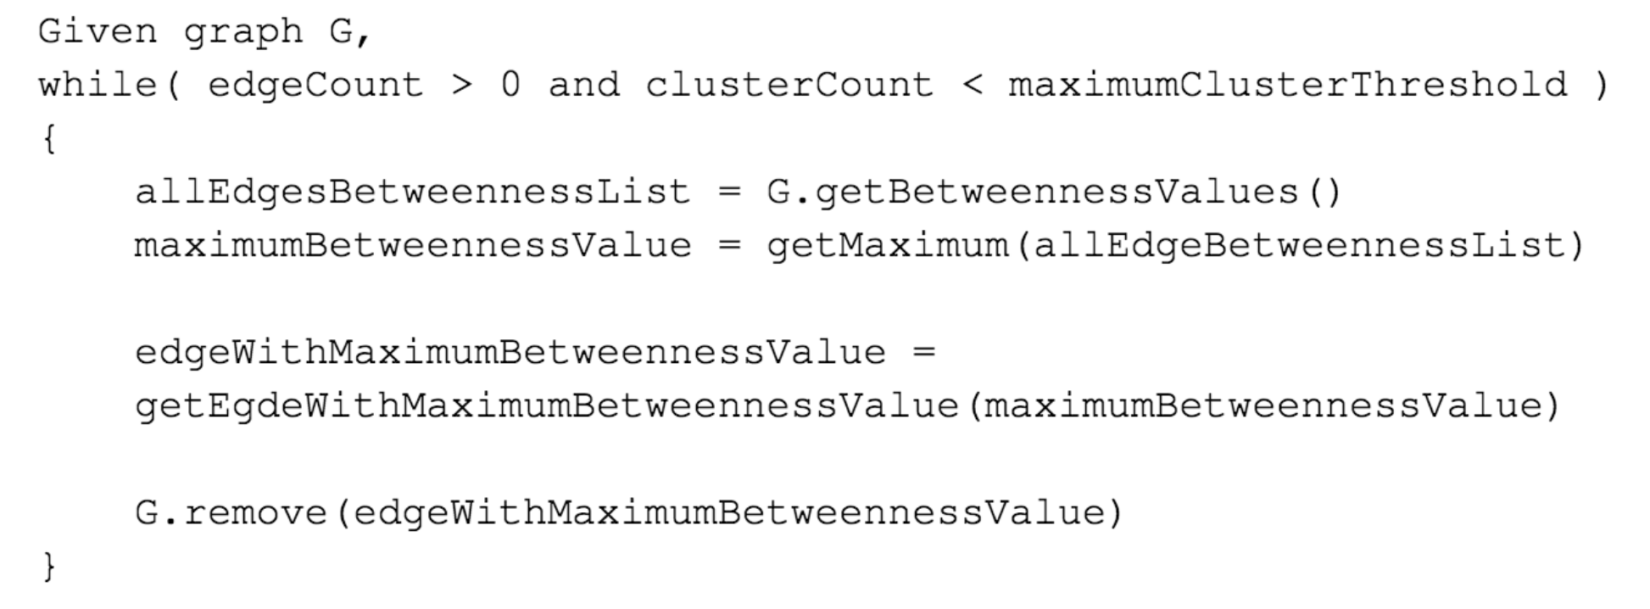
Girvan-Newman Pseudocode
Step 3
Step 1
Step 2

Slide 92
Karate Club splits after a dispute. Can new clubs be identified based on network structure?
Zachary W. (1977). An information flow model for conflict and fission in small groups. Journal of Anthropological Research, 33, 452-473.
Zachary's karate club (Wikipedia) / see data set at ZACHARY KARATE CLUB at UCINET IV Datasets and Zachary karate club at KONECT (archived)

Slide 93
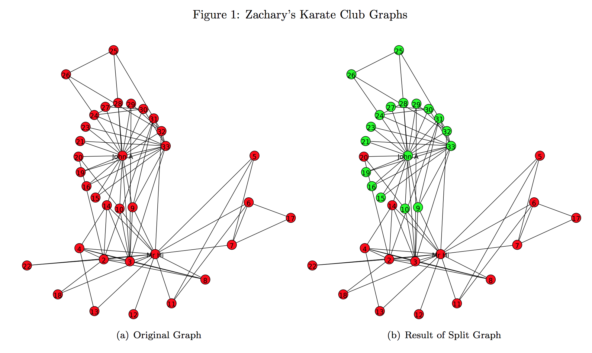
Girvan-Newman run on Karate-Club graph
Graphs generated by Alexander Nwala, Fall 2014

Slide 94
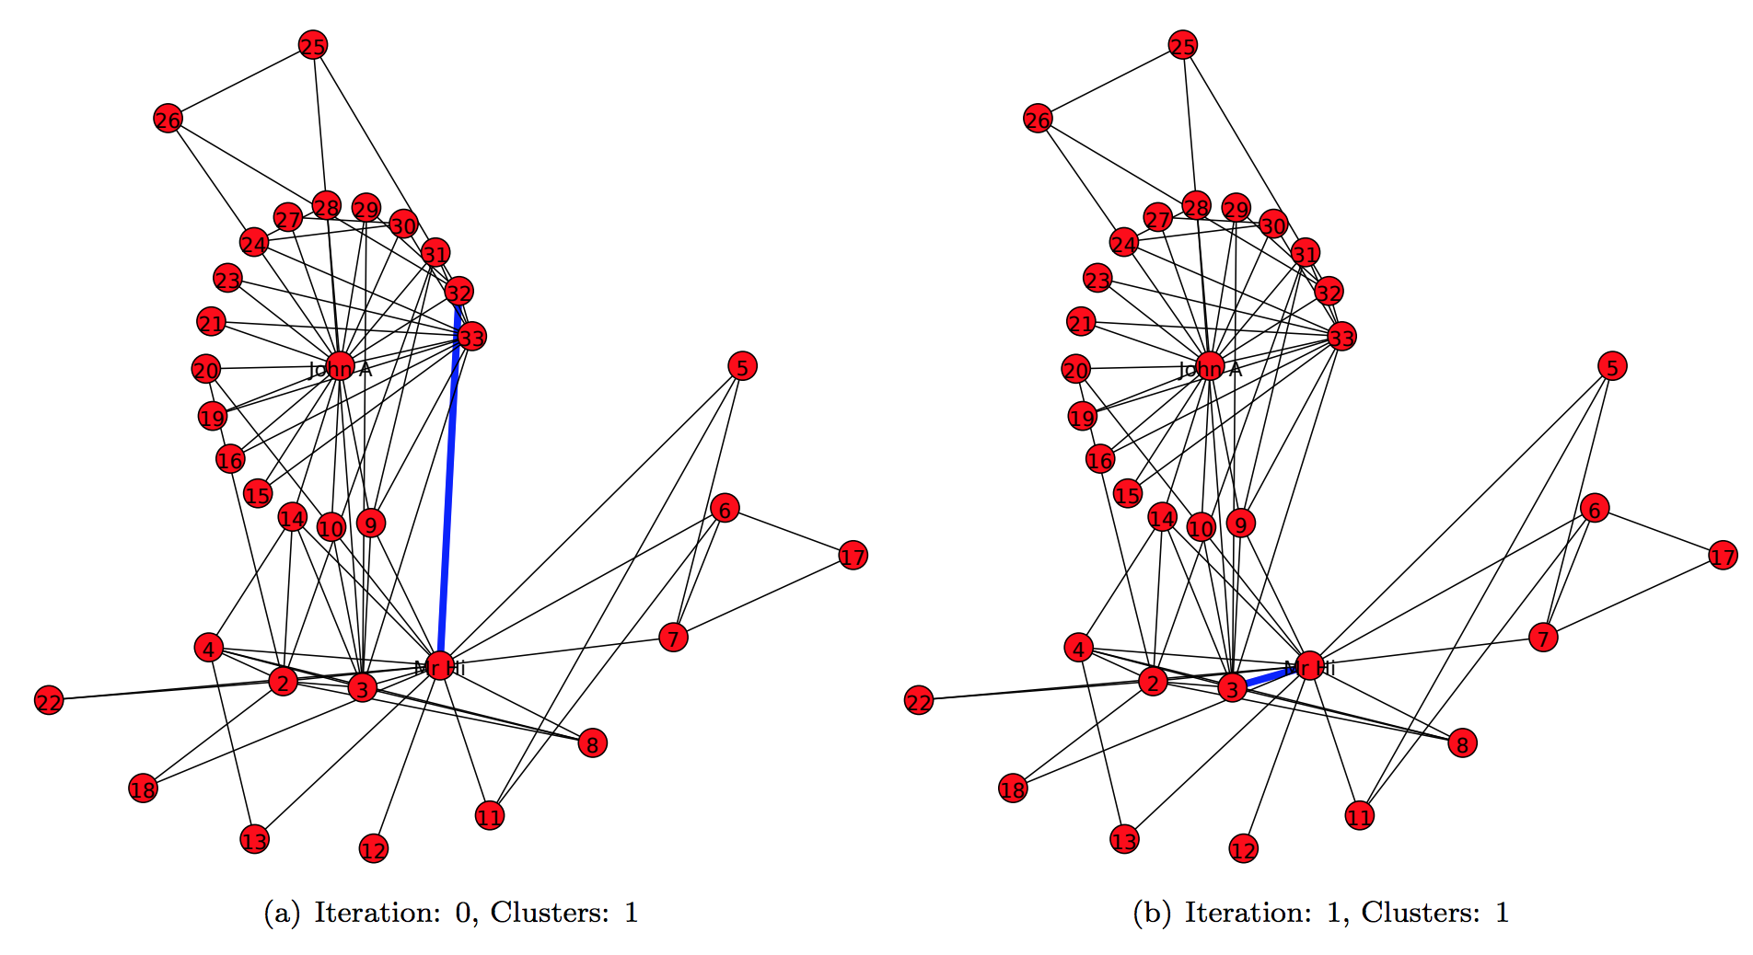
Girvan-Newman run on Karate-Club graph

Slide 95
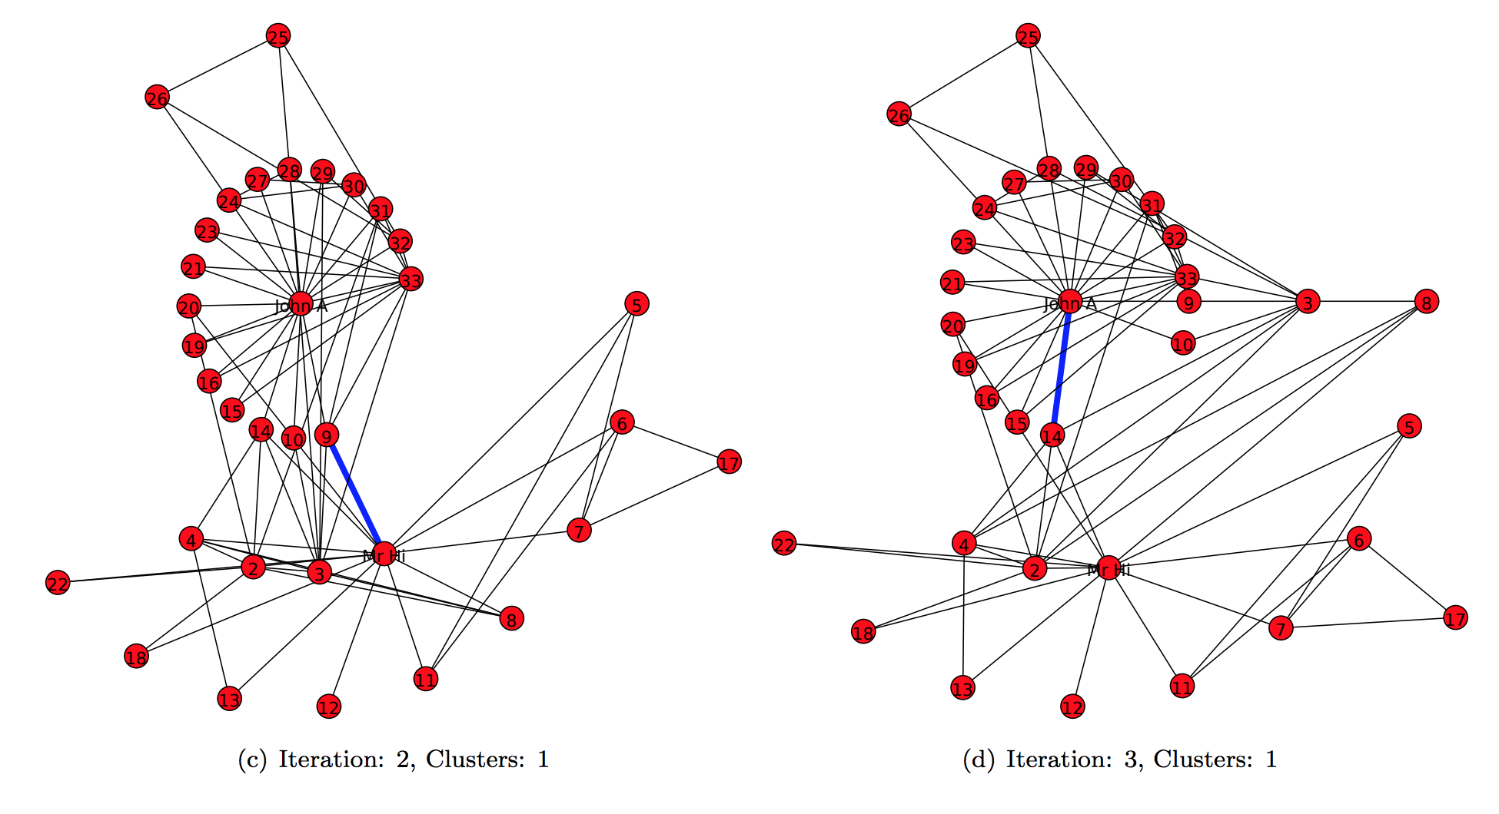
Girvan-Newman run on Karate-Club graph

Slide 96
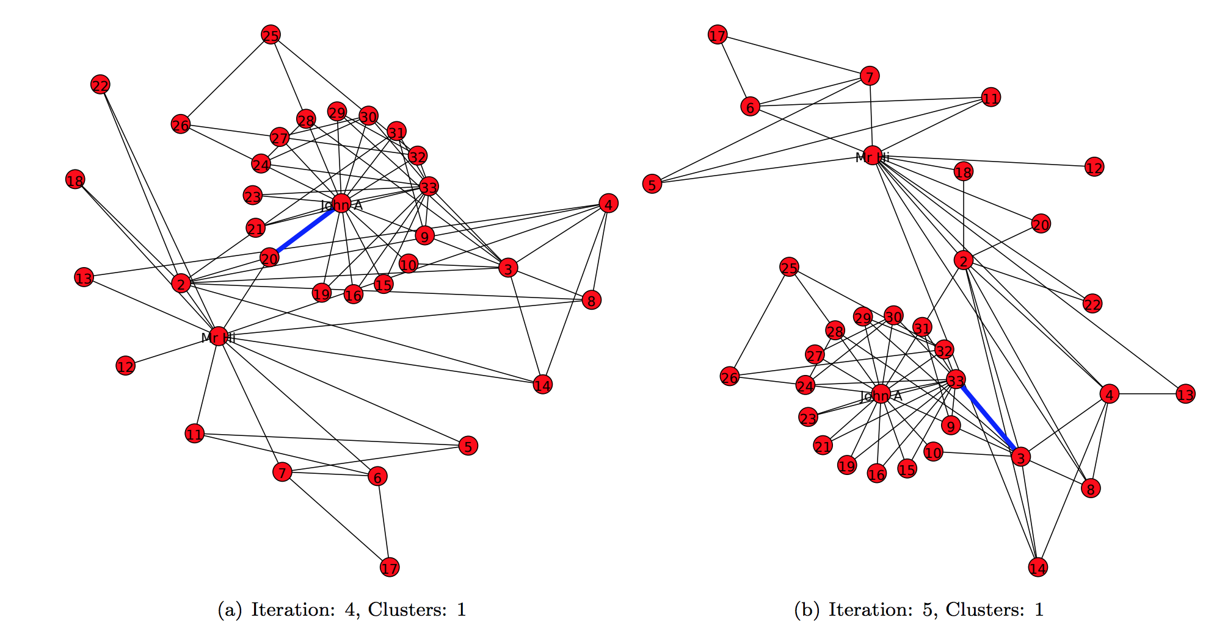
Girvan-Newman run on Karate-Club graph

Slide 97
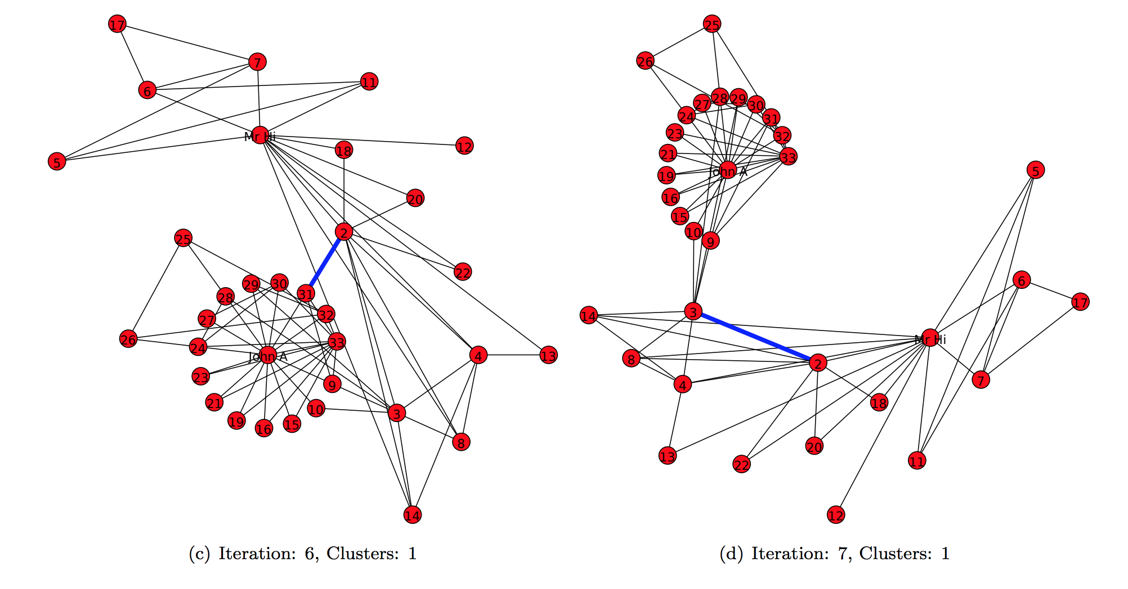
Girvan-Newman run on Karate-Club graph

Slide 98
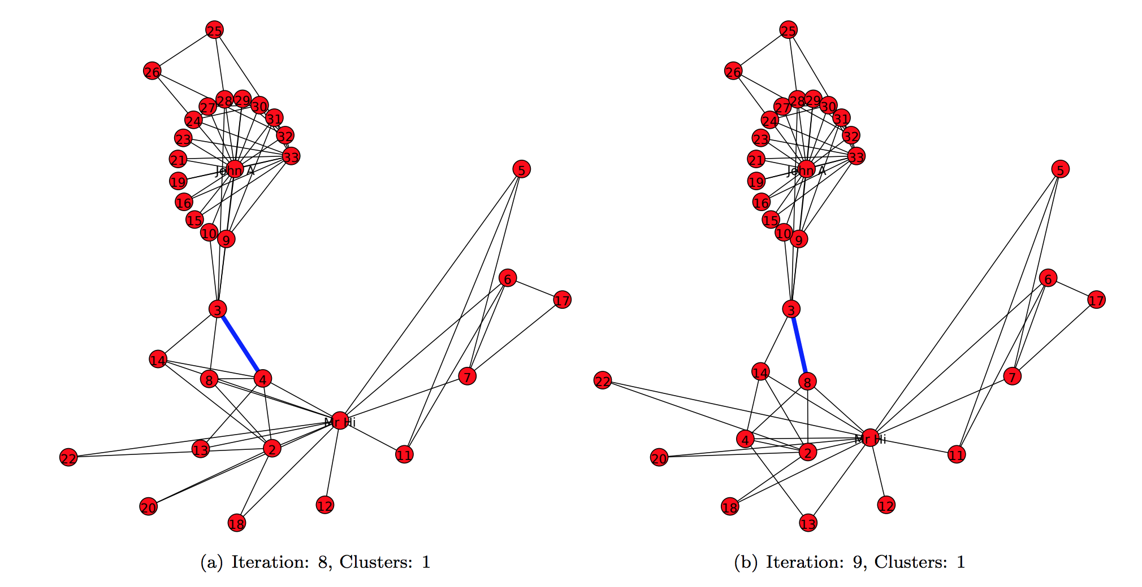
Girvan-Newman run on Karate-Club graph

Slide 99
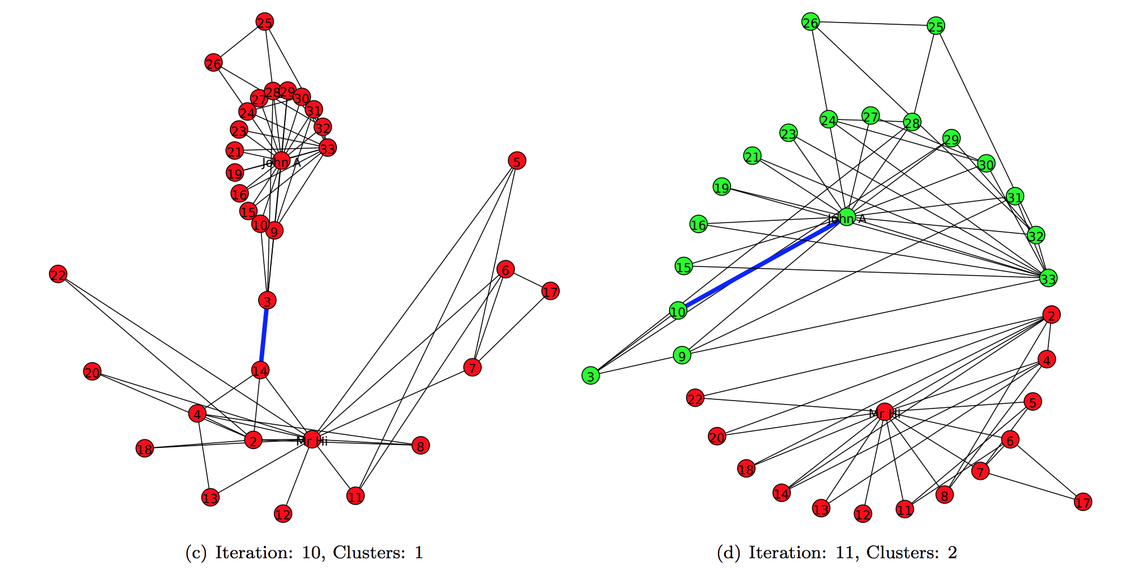
Girvan-Newman run on Karate-Club graph

Slide 100
Objectives
Describe the friendship paradox.
Explain the triadic closure in social networks.
Explain how edge embeddedness affects trust.
Explain the edge betweenness property.
Explain the steps in the Girvan-Newman graph partitioning algorithm.

